Slide 1
Conversion Calculator
A presentation on
Presented by
Abdur Rawf Akand (IT 23050)
Md. Tajul Islam (IT 23051)

Slide 2
Welcome
To presentation on Conversion Calculator

Slide 3
content
Introduction
Project Overview
Project Structure
Key Functionalities
Output
Challenges and Learning
Future Scope
Conclusion

Slide 4
Introduction
Objective of the Project:
Develop a C program to handle common unit conversions in different categories.
Primary Features:
1. Convert units for Length, Weight, Temperature, and Volume.
1.Log conversion history with timestamps.
2.Ability to view and clear conversion history directly from the program.
Benefits of Using C:
1.Efficient handling of modular functions.
2.Access to low-level operations like file handling.
3.A stepping stone for understanding basic input/output and conditional structures in programming.

Slide 5
Project Overview
Purpose:
The calculator supports various unit conversions for length, weight, temperature, and volume.
Key Objectives:
1.Provide accurate unit conversions for a variety of categories.
2.Track and log user activity to build a conversion history.
3.Offer a user-friendly menu-based console interface.
User Benefits:
1.Simple and quick conversions.
2.Reviewable history for past conversions.
3.Search functionality to find specific conversions by date.

Slide 6
Project Structure
Core Structure of the Project:
1.Main Menu:
Acts as the control center, guiding the user through various functions.
2.Modules:
Each conversion category (length, weight, temperature, volume) has its own dedicated function.
3.History Management:
Stores each session’s data and enables users to view or clear history.
4.Code Organization:
1. Functions are modular for easy debugging and enhancement.
2.File handling for history logs, making the project extensible.

Slide 7
Key Functionalities
1. Length Conversion
Converts between units such as:
1. Meters to Kilometers
2. Kilometers to Meters
3. Feet to Inches
4. Inches to Feet
5. Meters to Miles
6. Miles to Meters
7. Centimeters to Meters
8. Meters to Centimeters
2. Weight Conversion
Converts between units such as:
1. Grams to Kilograms
2. Kilograms to Grams
3. Pounds to Ounces
4. Ounces to Pounds
5. Kilograms to Pounds
6. Pounds to Kilograms
7. Stones to Pounds
8. Pounds to Stones

Slide 8
Key Functionalities
3. Temperature Conversion
Converts between units such as:
1. Celsius to Fahrenheit
2. Fahrenheit to Celsius
3. Celsius to Kelvin
4. Kelvin to Celsius
5. Fahrenheit to Kelvin
6. Kelvin to Fahrenheit
4. Volume Conversion
Converts between units such as:
1. Liters to Gallons
2. Gallons to Liters
3. Milliliters to Liters
4. Liters to Milliliters
5. Cubic Meters to Liters
6. Liters to Cubic Meters

Slide 9
History Management
How History is Managed:
Automatic Logging:
Each session is timestamped, recording date and time.
History Search:
Users can search past conversions by date, offering easy review.
View All History:
Option to see a complete log of all conversions.
Clear History:
Allows users to erase past logs, maintaining privacy or saving space.

Slide 10
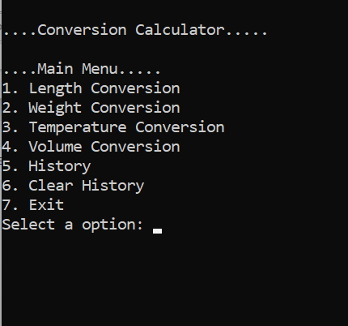
Output
User can select any Option.
Let user want to convert length and he select 1

Slide 11
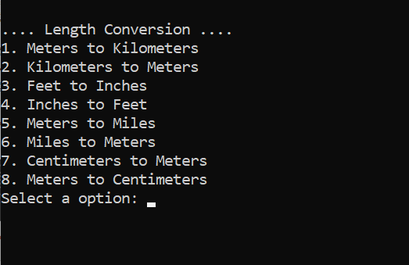
output
Then he find a Menu like this.
Let user want to convert Meters to Kilometers.Then he select 1.

Slide 12
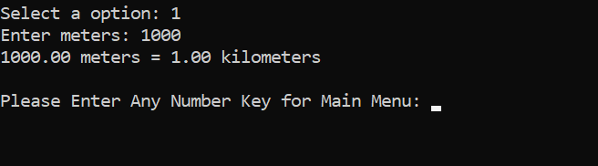
output
Then he can gives input and he can show converted output
Then he have to press any number for going Main menu

Slide 13
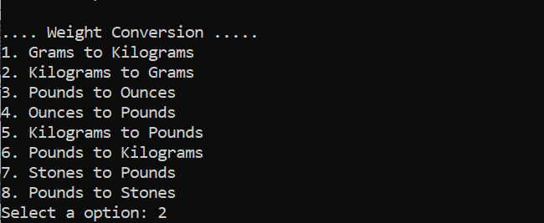
output
Now let user want to use weight conversion. Then he select 2 and he find menu like this .
Let he want to convert Kilograms to Grams. Then he will select 2.

Slide 14
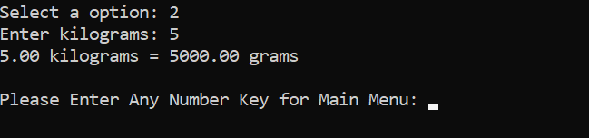
output
Then he will give input as kilograms and find output in grams.

Slide 15
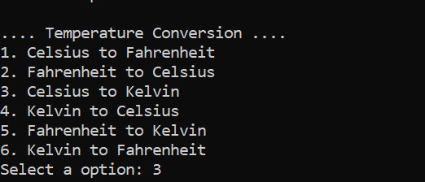
output
If user select option 3 he will find Temperature Conversion. He can select any kinds of temperature conversion.
Let user select Celsius to kelvin . And select option 3.

Slide 16
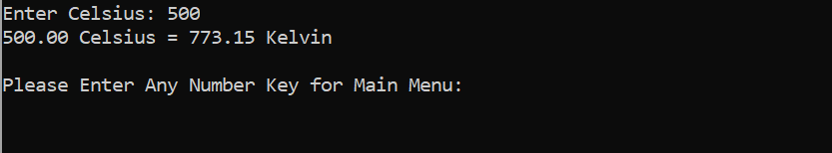
output
Then he will find option to give his input in celcius and he will find his output in kelvin.
Then he user enter any number for going main menu.

Slide 17
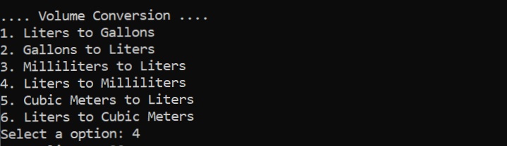
output
If user select option 4 ,then he will go on volume conversion.
Let user select option 4 that convert Liters to Mililiters.

Slide 18
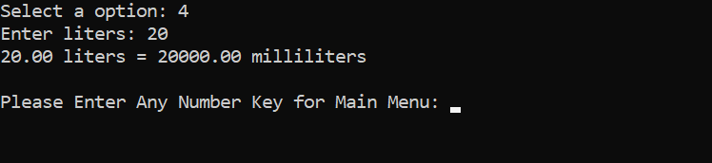
output
Then he will find option to give his inpute as liters and he will find output in mililiters
Then user press any number to go main menu.

Slide 19
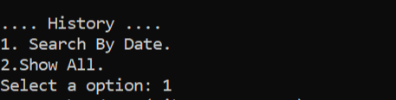
output
User can select 5 for history. Then will find two types of history:
Search by date
Show all.
In search by date, user input a specific date and he will find history for the date. And in show all option he will able to all history
Let user select option 1.

Slide 20
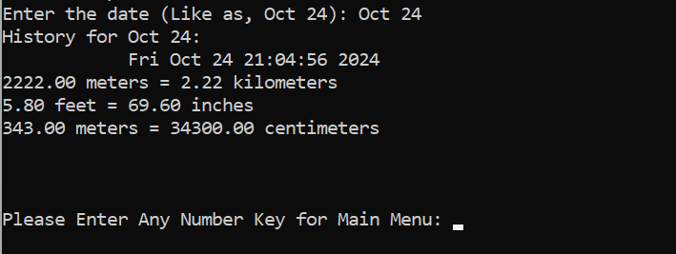
output
Here user is asked for a search , after input a date by user ,it will print history for this specific date with day and time .

Slide 21
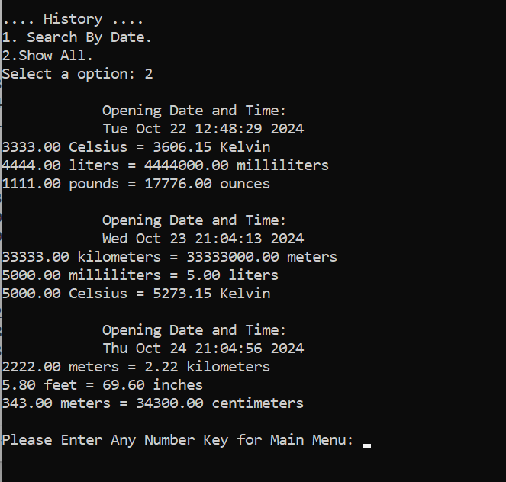
output
By chose 2, user will find history of all date with day and time.

Slide 22
output
If the user select option 6, then all the history will delete . And print a message like: history is cleared.
And if user want to exiting the calculator, he should select 7.

Slide 23
Challenges & Learnings
Challenges Faced:
File I/O Complexity:
Handling file operations in C, ensuring correct storage and retrieval.
User Input Validation:
Preventing errors from invalid input or menu selections.
Modularity:
Structuring the project into clear, manageable functions for easy maintenance.
Learnings:
1.Gained hands-on experience with C programming fundamentals.
2.Improved understanding of file handling, memory management, and modular code structure.
3. Developed skills in debugging and testing code, ensuring smooth user interactions.

Slide 24
Future Scope
Expansion Possibilities:
Additional Units:
Adding more units for each conversion type (e.g., energy conversions).
Graphical Interface:
Transition to a GUI-based program for a more user-friendly experience.
Enhanced History Search:
Filtering by unit type, session number, or specific dates.
Optimizations:
Code improvements for faster calculations and better memory management.

Slide 25
Conclusion
Summary of Achievements:
1.Developed a robust and user-friendly conversion calculator in C, supporting a wide range of units including length, weight, temperature, and volume.
2.Implemented a history management feature that allows users to view, search, and clear past conversions.
Key Takeaways:
1.Learned effective use of modular functions and file handling in C, enhancing both project structure and user experience.
2.Gained practical experience in designing user-friendly console applications with efficient data tracking.
Final Remarks:
1.This project serves as a solid foundation for future improvements, including additional conversion types and interface enhancements.
2.The project demonstrates how simple, functional applications can provide value and serve as a stepping stone to more complex programming challenges.

Slide 26
Thank You!
Any Question?

